Slide 1
Strengthening Outcomes and Assessment in Residency
SOAR
Advisory Committee
June 17, 2024
Notes:
Bump Gathering for lunch – let them know they are in the right room

Slide 2
Agenda for June 17
Where we’ve gone in ‘23-24
Where we are going in ‘24-25
How might we get to the next level?
Notes:
BumptLunch Slide – Table Host to Introduce themselves at each table

Slide 3
Advisory Committee
Where we’ve been:
Formed in 2022 as a small group from interested stakeholders
Occasional Zoom meetings, annual 90-minute learning session
Key discussion: What is the community about
SOAR principles for a community of practice
What is a GME outcome
Engaging potential scholars (aka SOAR fellows)
Commitment to learning
Where are we going in 23-24?
What GME outcomes might we focus?
What does successful engagement look like?
What are the key drivers of clinical and socially accountable outcomes?
How do program leaders think and talk about QI with a lag time between the outcomes and the curricular/care delivery structure?
Notes:
Jay

Slide 4
Advisory Committee
6 new members
Barbara Miller, MD new co-chair representing the AFMRD
Lisa Ochs, new Executive Director of AFMRD
Convene quarterly via Zoom
Convene face to face annually in addition to the learning session
New advisory committee
2 new SOAR Scholars
(Now 4 total scholars)
Notes:
Jay

Slide 5
Community of Practice
“Groups of people who share a concern or a passion for something they do and learn how to do it better as they interact regularly.”
--Etienne Wenger,
Social Learning thought leader
Notes:
BumptLunch Slide – Table Host to Introduce themselves at each table

Slide 6
Where we’ve been
~150 initial explorers in 2023 [AAFP]
~ 75 additional potential members in 2024 [AAFP, ACOFP, STFM]
Some limited sharing
4 featured “promising practices”
Identify using data from National Grad survey
Learn context and key details
Get wisdom of other experienced program leaders
Explore key drivers/key components – surface what are most important and spread
SOAR Community
Notes:
Jay Fetter

Slide 7
What we’ve learned?
Potential community members are interested in GME outcomes
Leaders of newer programs are really interested in the data/evidence
Modest uptake in viewing ABFM GME survey data
Some programs don’t have data yet or may not until they have sufficient number of grads
Some use in APE/PEC process by quite variable as is the APE/PEC/Self Study process
Recency effect – how does SOAR help me meet the new program requirements now?
For less interest, SOAR is just ‘another thing’ [connected to feelings of burnout]
SOAR Community
Notes:
Jay Fetter

Slide 8
What we’ve learned?
I don’t want more emails
I would engage if:
“push a button” functionality (simple)
Relevant to my program and situation!
Learning loops are respectful of my time
Included all program faculty
Builds capacity
Isn’t threatening
I got help to analyze/context the outcomes
Uses existing learning workflow from like of AFMRD, STFM, RRPD and THCPD grant recipients
SOAR Community
Notes:
Jay Fetter

Slide 9
Where are we going?
[input needed]
Transition from community explorers to community members [invite/ask them to be members]
Members at least co-driving [sensitive to members time and commitment] further development
Increase engagement with members and exemplars with quarterly Zoom learning events featuring GME outcomes and program features
Double the amount of time at the face-to-face learning collaborative
Contextualize data [you are here]
Featured SOAR highlights in existing org channels with AFMRD, STFM, ADFM, Family Medicine Residency Administrators, RRPD and THCPD grant recipients
SOAR website/GME hub improvements
Notes:
Jay

Slide 10
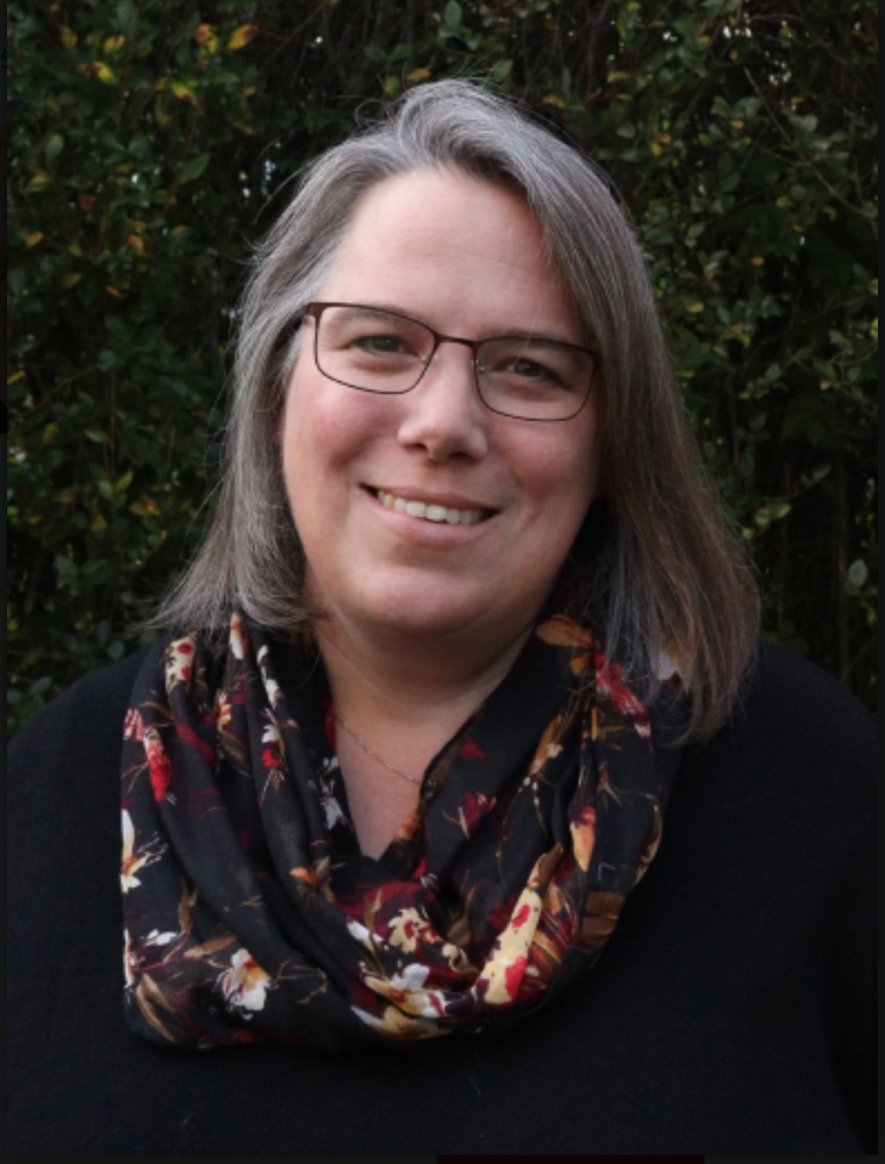
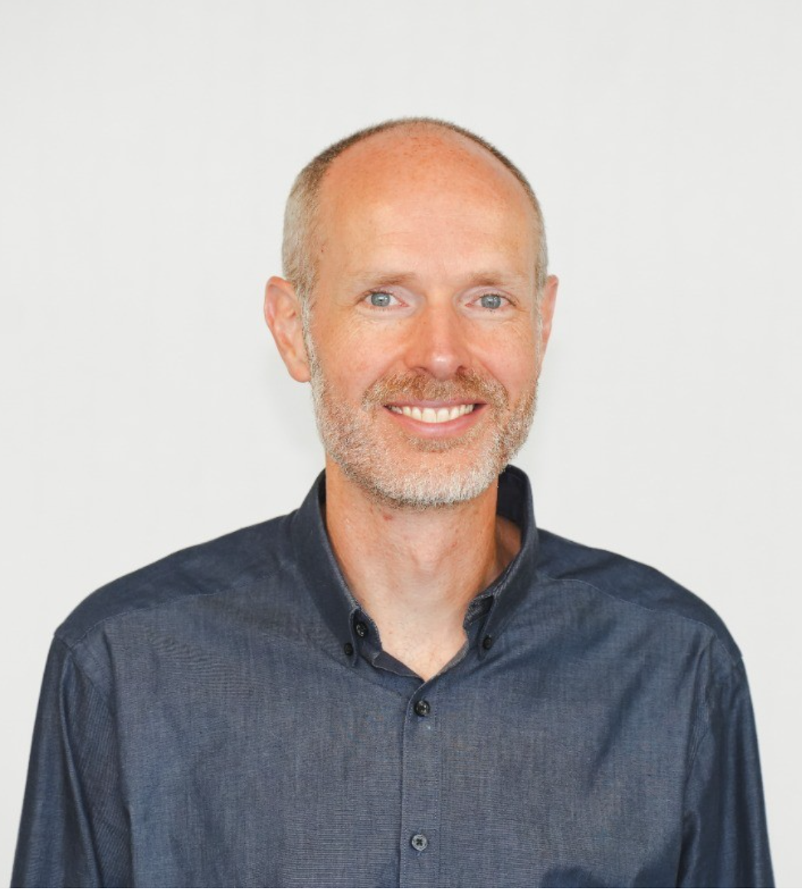
GME Outcomes for Residency Design and Redesign
Wendy Barr, MD, MPH, MSCE | FM-ROP
Lars Peterson, MD, PhD | ABFM

Slide 11
Promoting High Quality, High Functioning Primary Care
Family Physician
Healthcare System
Training
Payment Models
Personal Preferences

Slide 12
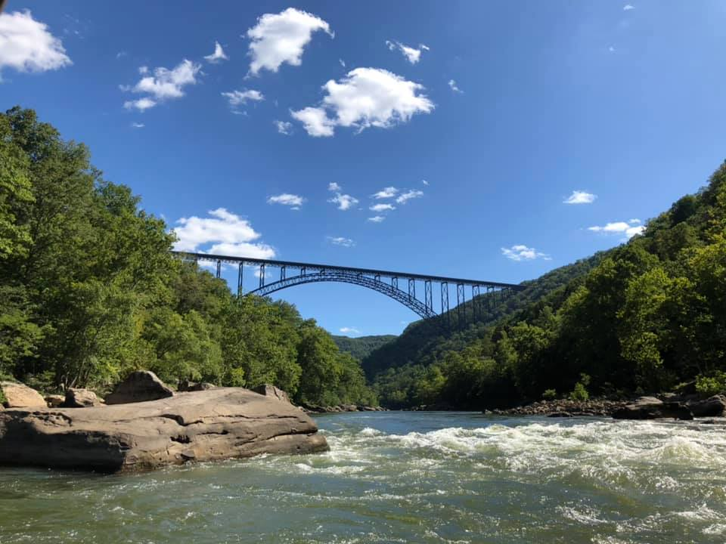
Define Your Outcomes
What do you want for your graduates?
Location of practice
Scope of practice
Master Adaptive Learners
Resilience to do the work (Wellness)
$$$$
High quality care

Slide 13
{Sample} How do we get the outcomes we want?
Outcomes
Structures
Processes

Slide 14
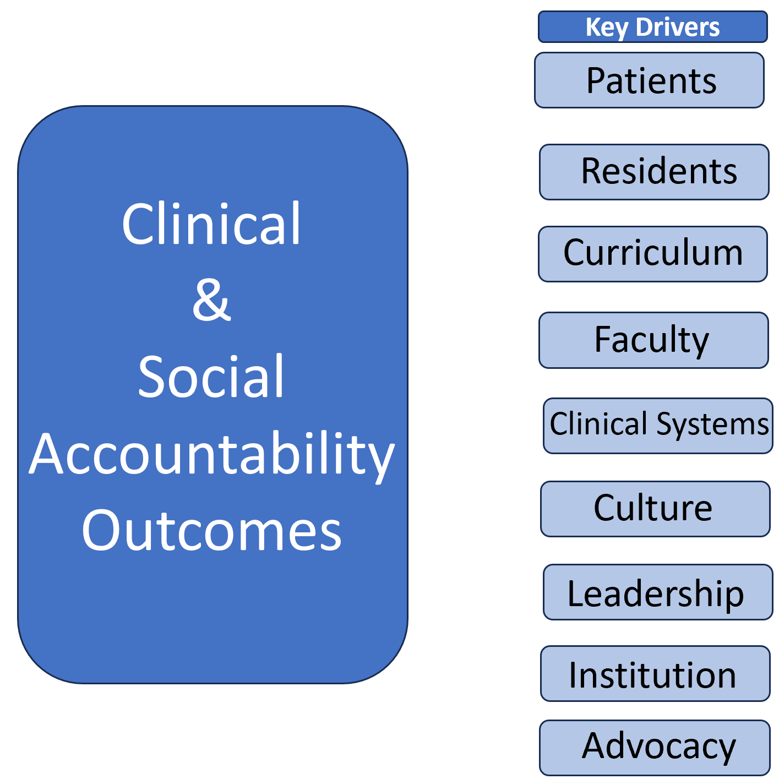
Key Drivers/Key Components
Key Components
Notes:
Warren

Slide 15
What is possible?

Slide 16
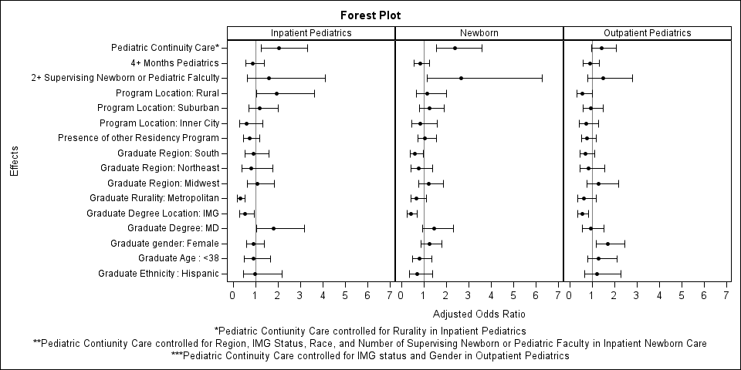
Using Current Research Looking at Processes and Outcomes - FMROP
What processes in residency programs are associated with graduates who care for children?
More block curriculum time in pediatrics
FM faculty who care for sick (inpatient) children and/or newborns
Seeing more children in continuity clinic during residency

Slide 17
What are the surgeons doing?
The SECOND Trial
Surgical Education Culture Optimization using targeted interventions based on National comparative Data

Slide 18
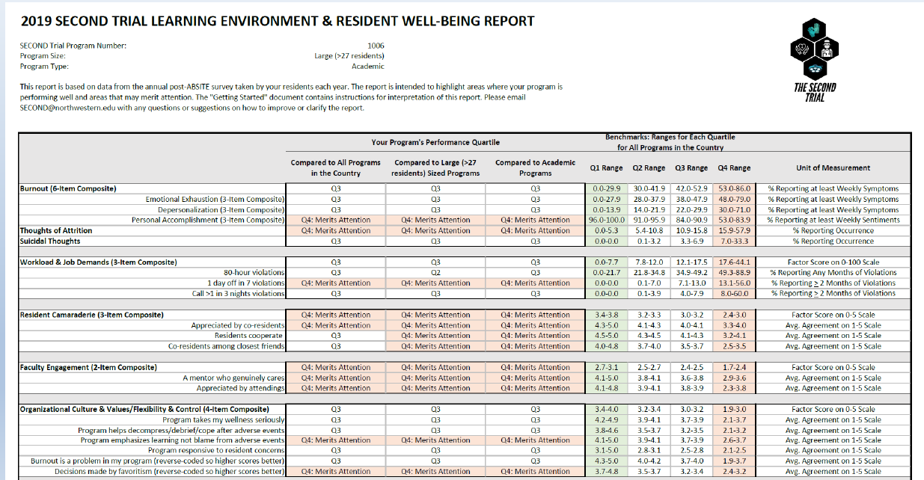
The SECOND Trial
Use quantitative and qualitative data to discover processes that work to achieve desired outcomes
Wide variability between programs → learn from the outliers
Develop Toolkit to share and spread these interventions/processes
Support communities of practice to share learnings and support each other in change journeys with the Toolkit
Test this using an RCT design (some programs get Toolkit and support and some program just get information)

Slide 19
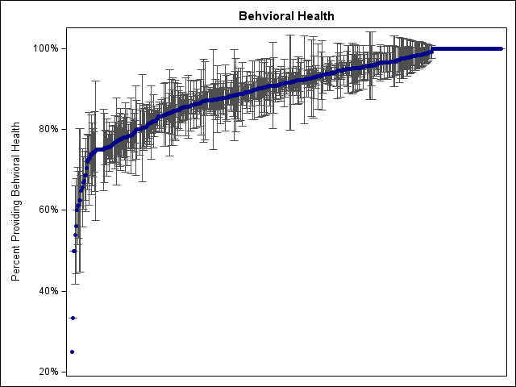
Distribution of GME Outcomes by FM Residency
Each vertical line represents data from one program
5 Year Averages with Standard Deviation represented
Programs with data in the National Graduate Survey
Needed to have at least 3 respondents
Notes:
Jay to briefly review plot

Slide 20
SOAR Promising Bright Spot: Behavioral Health
Trinity Health Grand Rapids FMR
Initial accreditation 8/26/1972
Initial start 7/1/1973
First Graduate 6/30/1975
Grand Rapids, MI
2nd most populated city in Michigan
City of ~200,000, Metro area 1.1 million
Furniture City, River City, Beer City
Leadership
PD – Michael Bishop, MD, FAAFP
APD – Mario Cesario, MD, PhD
PM – Alicia Crispin, C-TAGME
CAO/DIO – John vanSchagen, MD, FAAFP
Notes:
Michael Bishop

Slide 21
Trinity Health Family Medicine Residency
Trinity Health Medical Group – Academic Family Medicine – Grand Rapids
~14,500 total
8,500 (Resident PCP)
0-17 (20%), 18-64 (70%), 65+ (10%)
6,000 (Faculty PCP)
0-17 (15%), 18-64 (65%), 65+ (20%)
Current Faculty # – FMP 9
Payment/Contracts: Combination of Fee for Service and Alternate Payment Models (40/60)
Notes:
Michael Bishop

Slide 22
Trinity Health Grand Rapids
The mission of the Grand Rapids Family Medicine Residency is to create a learning environment where everyone can experience the joy of Family Medicine and nurture residents to become balanced, qualified, caring physicians.
We will achieve our mission through excellence in Patient Care, Education, Scholarship and Community Engagement
Program Aims:
Engagement in lifelong learning and educational innovation—We seek excellence in education through persistent innovation by our faculty, our residents, and our many community partners within a collaborative, multidisciplinary learning environment
People-Centered Care—We seek to maintain a supportive, team-based environment that values the individual, cares for diverse and underserved populations, fosters the ability in our residents to understand their patients’ stories within a psychosocial and community context, and provides effective and compassionate care throughout all stages of life and in every setting.

Slide 23
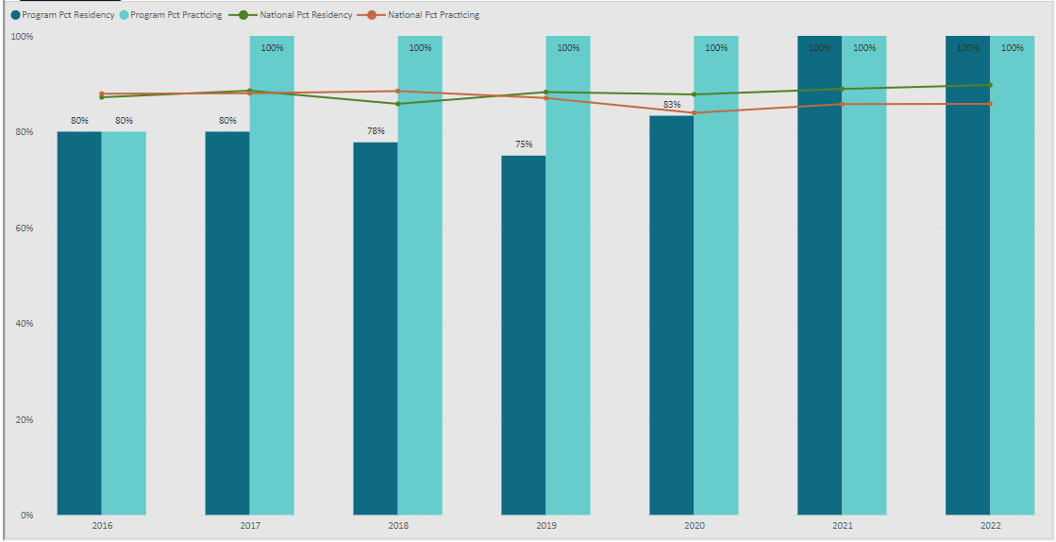
Behavioral Health – GME Outcomes
Trinity Health Grand Rapids Family Medicine Residency
Notes:
Michael Bishop

Slide 24
What We Do (enabling activities)
In Grand Rapids, there is/has been a significant lack of mental health resources
Our hospital system takes on the majority of the mental health burden in the community
Broken ground on a new inpatient behavioral medicine free standing facility
Behavioral Crisis Unit is opening in April 2024
The management of the at-risk patient population has fallen to our safety net clinic
Notes:
Michael Bishop

Slide 25
What We Do (Enabling activities)
Care Delivery
Integrated FMP – Practice in Teams of 2 attending physicians and 6 resident physicians
Initial integration occurred in AY2017-18 (2021 survey results)
Integrated LMSW, Community Health Workers, Case Managers
Notes:
Michael Bishop

Slide 26
What We Do (enabling activities)
Care Delivery
Integrated FMP – Practice in Teams of 2 attending physicians and 6 resident physicians
Integrated LMSW, Community Health Workers, Case Managers
Curriculum
Community & Population Medicine in PGY1 includes care of the unhoused population as well as those with significant mental health challenges
Every 3 years, Poverty Simulation run in conjunction with local non-profit
Brought in Psychiatrist to teach quarterly topics during didactics
Notes:
Michael Bishop

Slide 27
Scalable to Others I
Director of Behavioral Medicine
1.0 position. Shared between GME programs although bulk (0.6) time dedicated to FM
PsyD currently fills the role
Invaluable support to program, faculty, residents alike
Also coordinates BM didactics and curriculum
Notes:
Michael Bishop

Slide 28
Scalable to Others II
Video Review Sessions with Behavioralist
iPad on wheels into the room
Secure Connection through Teams Program (Virtual Rounding program developed during COVID)
Debrief after visits and at end of session
Occur every 2 blocks (on average)
No change in schedule template for these half days
PG2 – 35 min OV (5/half day)
PG3 – 25 min OV (8-9/half day)
Notes:
Michael Bishop

Slide 29
Scalable to Others III
Clinical Pharmacologist with Collaborative Practice Agreement
Management of:
Diabetes Mellitus, Hypertension, Hyperlipidemia
Medication Review, Medication Teaching
Polypharmacy Consultation
Depression, Anxiety, GeneSite testing
Osteoporosis, Obesity

Slide 30
Scalable to Others IV
Patient Handoff
Major Medical Problems (just a listing/highlights)
Relevant Tips/Tricks
Psychosocial factors
Family member/dynamics
Refill processes
Notes:
Michael Bishop

Slide 31
Take the next step
Example
To assure my new program produces a ____ % of graduates doing _______ in practice.
To increase the number of graduates in my program doing ____________ by ______% by 2027.
Key Drivers
Sequence of Curriculum – blocks vs interleaved
Increased direct observations
Work based assessments by multiple faculty
Faculty coaching to residents
Resident/patient continuity
Co-development with residents of curriculum
Change idea that we could implement in the next 12 months:
Interleaved curriculum, co-development
Next step: I will put this change idea on the next 2 quarterly APE meetings
Notes:
Sarah and Jay

Slide 32
Focused Discussion Topics
[input needed]
Care of Children | Newborn Hospital Care | Peds OP Care | Peds Hosp Care
POCUS
Behavioral Health
Intubation
IUD Insertion & Removal
Join aspiration and injection
LARC
Lumbar Puncture
Maternity care
MSK Ultrasound
Delivering babies
OB Ultrasound
OMT
POCUS
Cardiac Stress Test
Abortion
Thoracentesis
Vasectomy
Ventilator Management
Scope Score
Principle practice site/type [e.g. rural
Adult Inpatient
Buprenorphine Treatment
Integrative Health Care
Casting
Central Line
Neonatal Circumcision
Colonoscopy
Uterine Aspiration
Endometrial Biopsy
Endoscopy
End of Life Care
Management of Hepatitis C
Management of HIV AIDS
Intensive Care

Slide 33
Tools for Self Study
[Input Needed]
Problem Statement | Solution
Broad variability of Annual Program Evaluation (PEC) agenda and structure | Samples of PEC agenda
Broad variability and usability of Self Study reports (Annual Program Evaluation) | Samples of exemplar APE reports
Difficult to reconcile lagging outcomes against residency infrastructure | Study and publish of analysis that help programs use GME Outcome data for improvement of current program structure
Don’t have Grad Survey Data | Produce cases studies of using other source of data such as ACGME data for improvement
No single repository of “the evidence” | SOAR website and GME up development

Slide 34
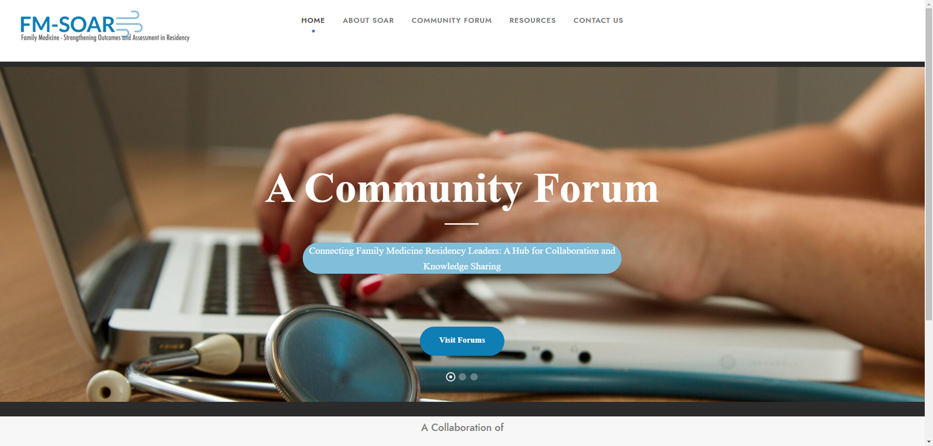
SOAR Website and Community Forum
www.fmsoar.org
Notes:
Jay

Slide 35
How do we take SOAR to the Next Level?
If our success was guaranteed, how many members must we recruit to participate in 2024?
If our success was guaranteed, what areas of study should our scholars be actively investigating?
If our success was guaranteed, how might we ensure that residency programs are engaged in self study using data to guide their work?
If our success was guaranteed, what might we need for our live learning session in 2024 to attract the most members and potential members to the conversation(s)
What challenges might we encounter in 2024 and how might we navigate them?

